Slide 1
FACE MASK DETECTION USING CNN DEEP LEARNING ALGORITHMS
By
DINESH S
SIVASUBRAMANIAN S
SUGUMAR S
RAJARAM S

Slide 2
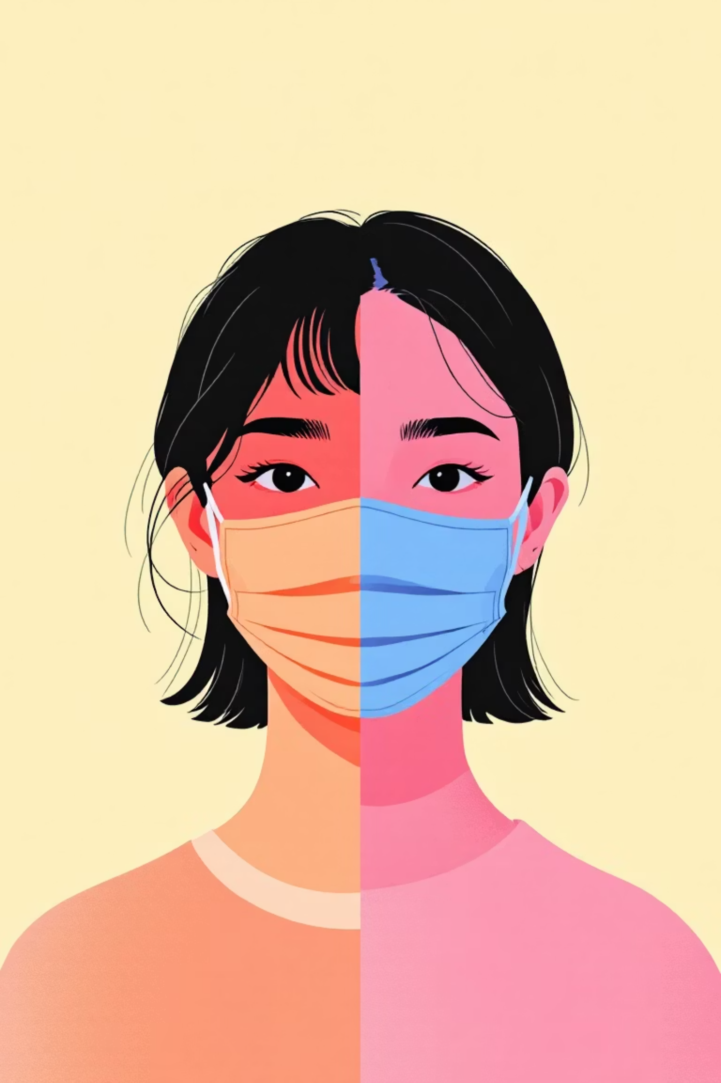
Classification Challenge
With Mask
Without Mask
Properly covered nose and mouth, various mask types including surgical, N95, and cloth variants
Exposed facial features, clear visibility of nose and mouth areas for detection

Slide 3



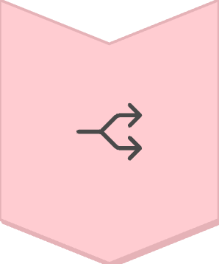
Dataset Preprocessing Pipeline
Image Resizing
Standardised input dimensions for consistent processing across all samples
Normalisation
Pixel value scaling to improve convergence and training stability
Data Augmentation
Rotation, flipping, and brightness adjustments to enhance dataset diversity
Train-Val-Test Split
Strategic partitioning ensures robust model evaluation and prevents overfitting

Slide 4
CNN Architecture Overview
Convolutional layers systematically extract facial features through hierarchical pattern recognition. Early layers detect edges and textures, whilst deeper layers identify complex facial structures and mask presence indicators.
01
02
Feature Extraction
Spatial Reduction
Convolutional filters capture local patterns
Pooling layers compress spatial dimensions
03
Classification
Dense layers output binary predictions

Slide 5
Generalisation Techniques
Data Augmentation
Dropout Regularisation
Early Stopping
Synthetic variations increase training diversity, improving model robustness across lighting conditions and angles
Random neuron deactivation prevents overfitting by forcing distributed feature learning
Training halts when validation performance plateaus, avoiding memorisation of training data

Slide 6
Transfer Learning Advantages
Pre-trained Models
75%
MobileNetV2: Optimised for mobile deployment with depth-wise separable convolutions
Training Time Reduction
ResNet50: Deep residual networks enable training of very deep architectures
95%
Transfer learning leverages ImageNet pre-training, dramatically reducing computational requirements whilst achieving superior accuracy on limited datasets.
Accuracy Improvement

Slide 7


Training Configuration
Adam Optimiser
Cross-Entropy Loss
Adaptive learning rates with momentum for efficient convergence across diverse gradient landscapes
Binary classification loss function penalises incorrect predictions with logarithmic scaling

Slide 8



Comprehensive Evaluation Metrics
Accuracy & Precision
Recall & F1-Score
Confusion Matrices
Overall correctness and positive prediction reliability across balanced and imbalanced datasets
Sensitivity to true positives and harmonic mean balancing precision and recall trade-offs
Detailed breakdown of classification performance revealing systematic prediction patterns

Slide 9






Real-World Applications
Access Control
Entry validation for secure facilities and workplaces
Surveillance Systems
Automated compliance monitoring in public spaces
Embedded Systems
Edge deployment on resource-constrained IoT devices
High accuracy results demonstrate production-ready performance across diverse deployment scenarios, enabling scalable safety compliance solutions.

Slide 10
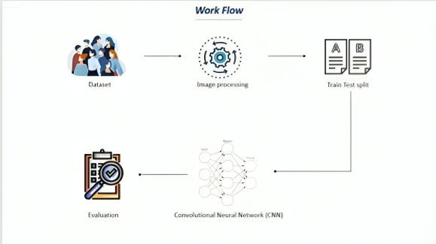

Slide 11
Technical Challenges & Limitations
Improper Mask Usage
Environmental Factors
Dataset Diversity
Partially covered faces and chin-strap positioning create ambiguous classification scenarios
Poor lighting conditions, facial occlusions, and extreme viewing angles challenge feature extraction
Bias towards specific demographics and mask types may limit generalisation performance
Future improvements focus on robust data collection, multi-angle training, and adaptive thresholding techniques.

Slide 12
RESULT
High accuracy in mask classification (With vs Without Mask)
Strong Precision, Recall, and F1-Score
Training time reduced by ~75% using Transfer Learning
MobileNetV2/ResNet50 achieved >95% accuracy
Confusion Matrix shows very few misclassifications

Slide 13
CONCLUSION
CNN-based system effectively distinguishes masked vs unmasked faces
Transfer learning improves accuracy and reduces training cost
Suitable for real-world deployment (surveillance, access control, IoT devices)
Challenges: improper mask usage, occlusions, lighting variations
Future work: dataset expansion, real-time video support, multi-class classification (e.g., incorrect mask usage)

Slide 14
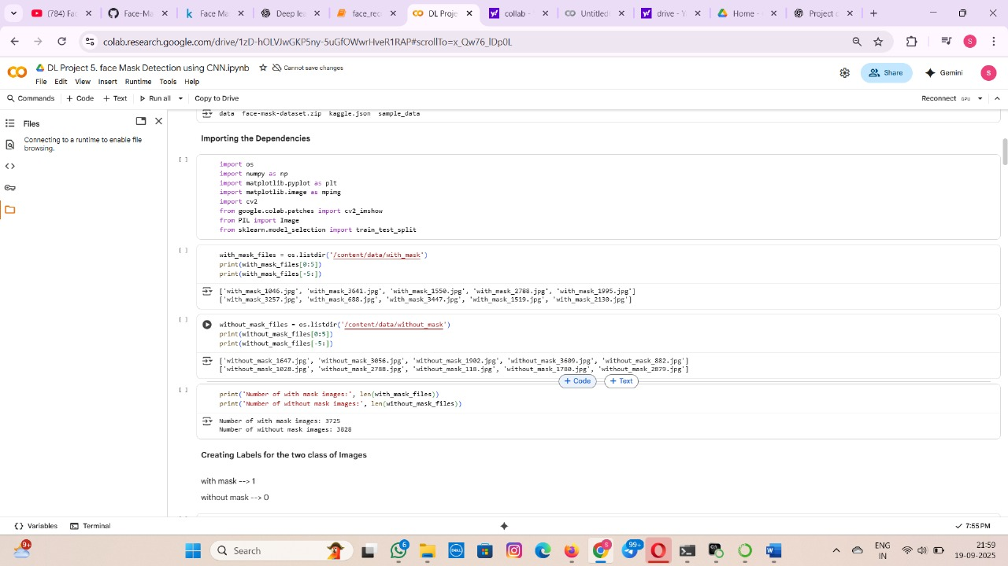
SCREEN SHOT

Slide 15
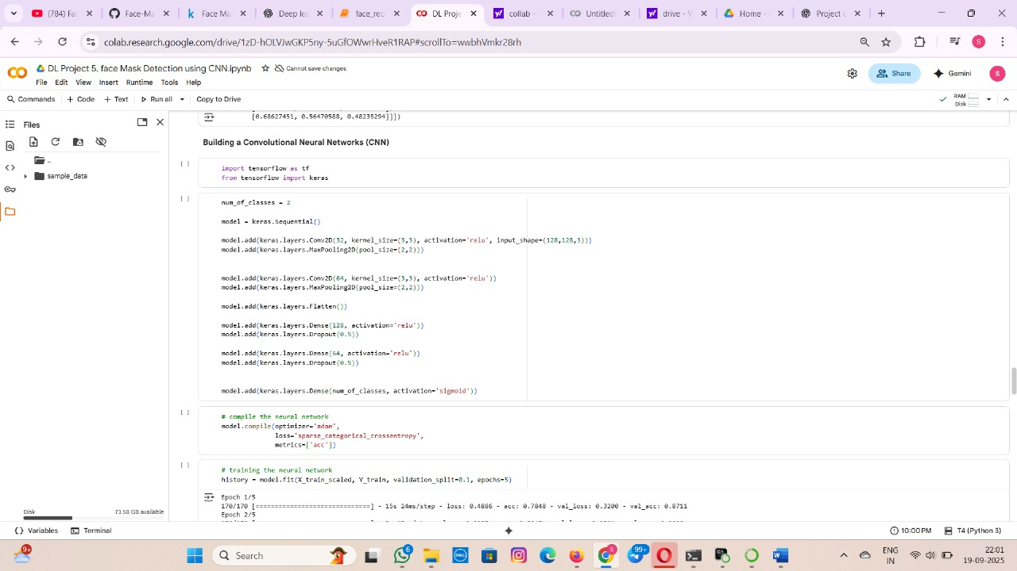

Slide 16
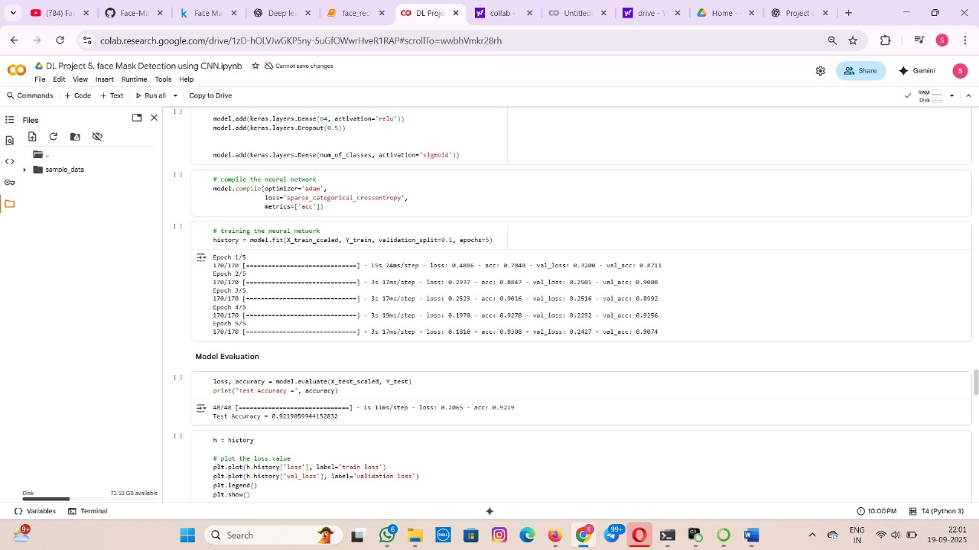

Slide 17
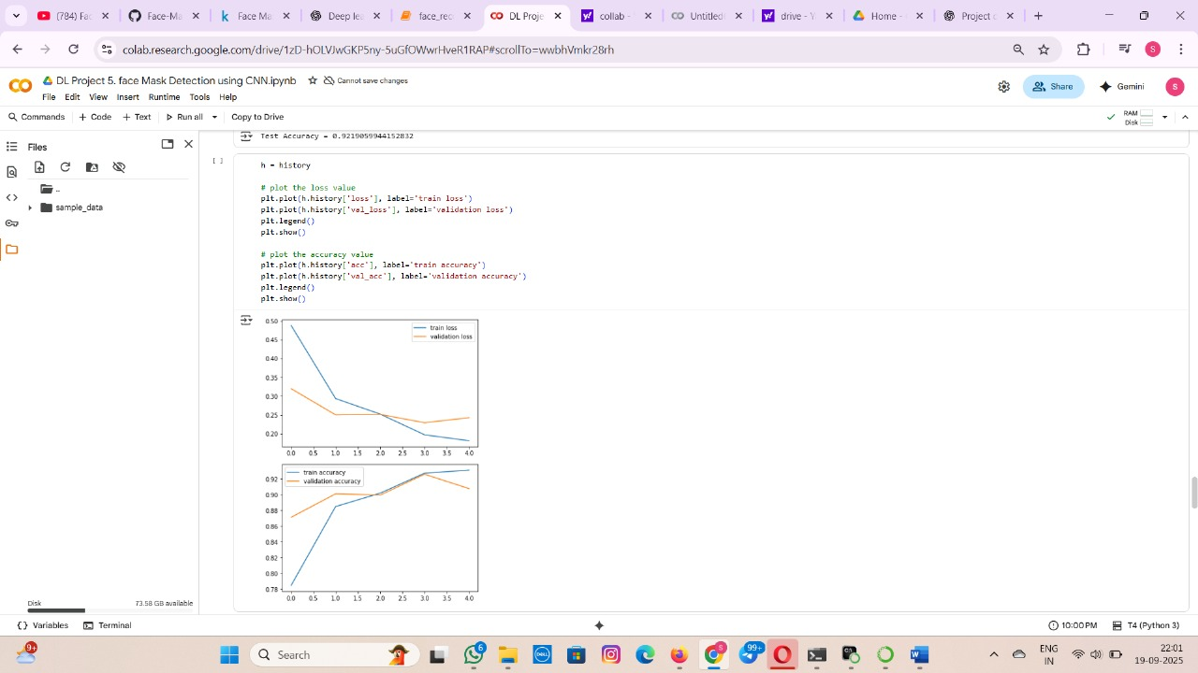

Slide 18
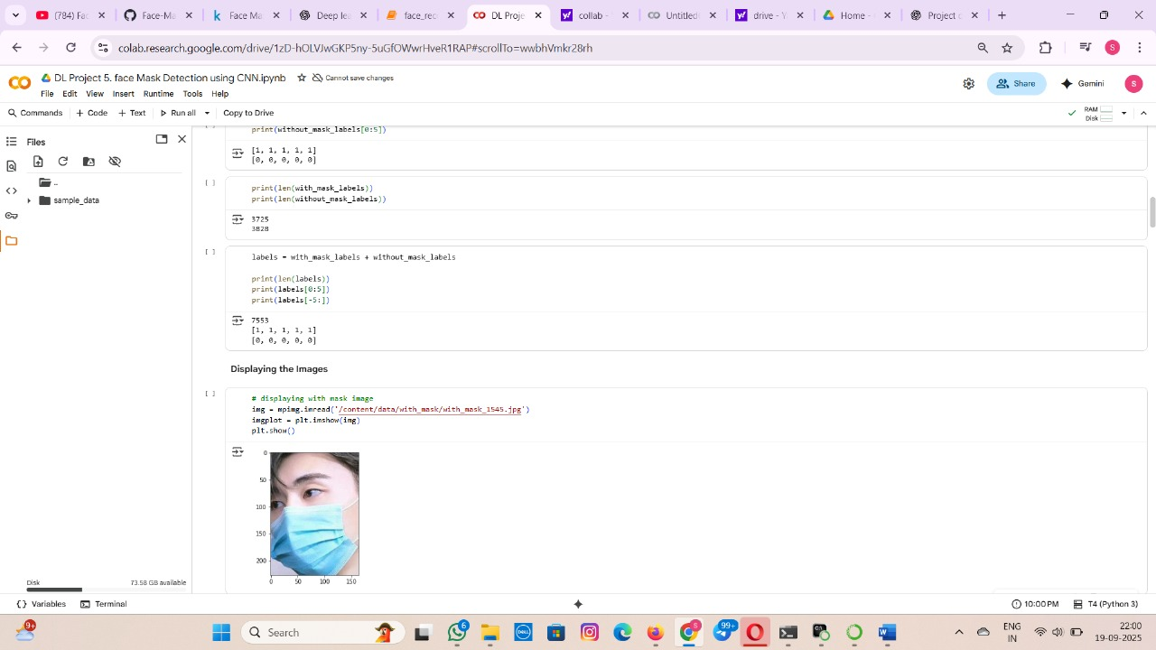

Slide 19
THANK YOU

